Slide 1
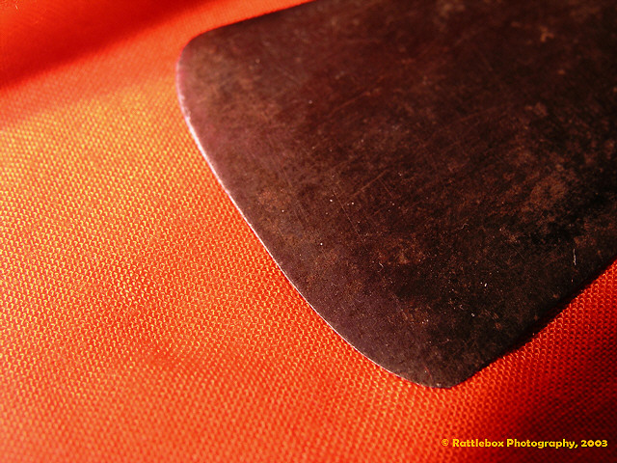
Ritualized Genital Surgery
Memetic Transmission in the Evolution of Complex Cultures

Slide 2
Origins of Genital Mutilation
Generally considered to be social tradition and not a medical tradition, though “health” benefits are sometimes perceived
  Can be seen as a group marker for both men and women which might have evolved due to large intergroup aggression
For women, the process originated to ensure chastity and virginity
  Most early medical documents indicate the purpose was to “reduce female sexual desire”
  Originally practiced by the royal families and priestly casts of Egypt
  Is more prevalent in areas where women’s social and economic standing is low (underdeveloped countries with rampant poverty and illiteracy)
For men the process originated for seemingly several reasons
  Religious purification so that men could produce and not be “consumed” with sex
  Did not have intercourse (eunuchs for protection of harems)
  But also “associates” men with a particular group so has something to do with in-group/out-group biasing (Jews could not be mistaken for Greeks)

Slide 3
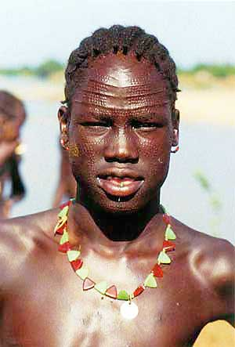
Traditional Societies
Body markings are common highly ritualized behaviors that concern a radical change in status
Often occurs around the time of puberty
Often not involve alteration of the genitalia

Slide 4
State Societies & Market Economy
Earliest recording was 5th century B.C. when slave traders sold infibulated women as “non-childbearing” women
Pre-state societies show little to no prevalence of MGM
Cultural evolution toward state societies greatly increased appearance of FGM because chastity could secure marriage and be used to purchase market goods
Families with girls that are circumcised can
  Collect bride price in some cultures
  Marry off their daughters

Slide 5
Cultural Adaptations
Once adaptations (memes) evolve in a society they can sometimes be very difficult to eradicate regardless of opposition
This has proved to be the case in the instance of genital surgery in modern times
These surgeries are known to cause significant health issues, yet still they persist even in so-called Western societies that practice “modern medicine”
80% of mothers and fathers that practiced FGM on their daughters did so to “uphold” tradition
If the meme predominates and is associated with significant benefit on the marriage market the adaptation will conquer and prevail often against radical attempts to change the situation
Eventually a threshhold is reached where one must go along with the tradition or move down on the mate status ladder

Slide 6
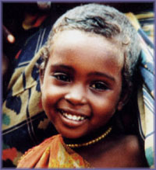
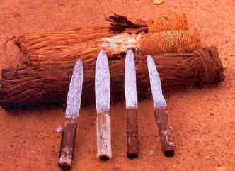
Female Circumcision
Term used for number of practices that involve partially or totally cutting off of the female clitoris
Can be performed from infancy through adulthood, but most common 4-12 yrs old
The practice is denounced by virtually all human rights groups worldwide
Yet 130 million women have undergone the surgery
Moslems, Catholics, Protestants, Copts, Animists, and non-believers

Slide 7
FGM Denounced by International Groups
The UN recommends that governments adopt clear national policies to abolish female genital mutilation and intensify educational programs about its harmfulness

Slide 8
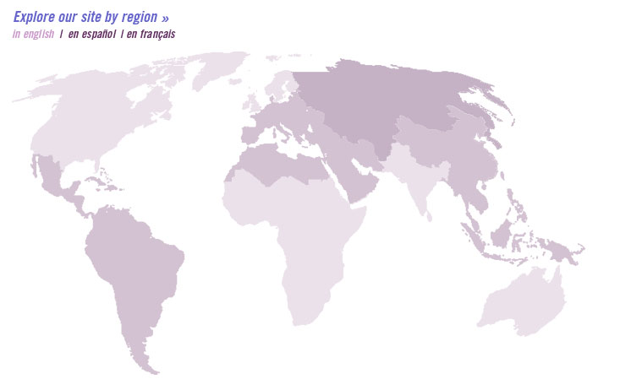
Prevalence
2 million new women and girls every year
Prevalent in 28 African countries (Somalia 98% of women)
15% have undergone Infibulation (Sudan, Somalia, Djibouti, Ethiopia, Kenya, Mali, Mauritania, Niger, Nigeria, Senegal

Slide 9
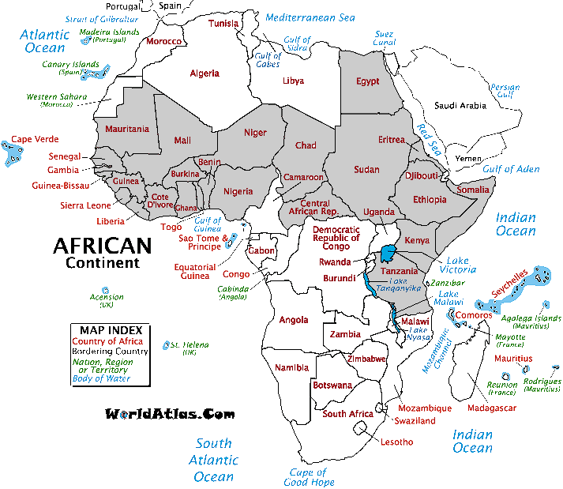
Africa
COUNTRY
PREVALENCE
ACTUAL NUMBER
Benin*
50%
1,200,00
Burkina Faso*
70%
3,290,000
Cameroon*
--
--
Central African Republic*
50%
750,000
Chad
60%
1,530,000
Cote d'Ivoire*
60%
3,750,000
Djibouti
98%
196,000
Egypt
50%
13,625,000
Ethopia and Eritrea
90%
23,940,000
Gambia*
60%
270,000
Ghana
30%
2,325,000
Guinea*
50%
1,875,000
Guinea Bissau*
50%
250,000
Kenya
50%
6,300,000
Liberia*
60%
810,000
Mali*
75%
3,112,500
Mauritania*
25%
262,500
Niger*
20%
800,000
Prevalence percent and actual numbers by country
Nigeria
50%
30,625,000
Senegal
20%
750,000
Sierra Leone
90%
1,935,000
Somalia
98%
3,773,000
Sudan (North)
89%
9,220,400
Tanzania
10%
1,345,000
Togo*
50%
950,000
Uganda*
5%
467,500
Zaire*
5%
945,000
Total
114,296,900

Slide 10
Cultural Groups
CONTINENTAL AFRICA: BENIN: Benin CHAD: Shuwa CENTRAL AFRICAN EMPIRE: Recently Outlawed DJIBOUTI: (Infibulation: entire population) EASTERN AFRICA*: Somali, Meru, Embu, Chuka, Kikuyu, Rangi, Nandi, Masai, Kamasia, Pokot, Elgeyo, Njemps, Dorobo, Sebei, Digo, Taita, Giriama, Kisii, Kamba, Swahili, Chaga, Pare, Gogo, Arusha, Tatoga, Turu, Bena, Hehe, Watusi, Xhosa, Suba, Wasembeti, Nilo-Hamitic population groups. ETHIOPIA: Amhara, Fellasha, Kafitscho, Oromo (Galla), Danakil, Tigre, Ometo, Hamitic Kufa, Babea, Sidmao, Kushite population groups; (Infibulation: Somali of the Harrar area*, Eritrea*) EGYPT: All population groups (Muslim and Copt) except for educated, urban upper, and upper middle class. GAMBIA: All population gouprs except Jolloff. GHANA: Hausa, Mossi, Yoruba, Kassina, Nankani, North Ghanaian groups*. GUINEA: 24 ethnic groups, including Foulah, Peul, Malinke (Mandingo), Soussou, Bambara, Kasonke, Serer, Wolof, Conakry area* KENYA: Masai, Kuria, Kisii, Nandi, Kipsigis, Kamba, Kikuyu, Digo, Taita, Giriama, Dorobo, Samburu, Kamasia, Elgeyo, Pokot (Suk), Embu, Meru, Terik, Marakwet, Chagga, Kavirondo, Watende, Wakamba, Kitosh, Lumbwa, (Infibulation: Somali). IVORY COAST: Malinke, Dioula, Guere, Guro, Baule, Mwan, are of Odienne*. MALI: Bambara, Dogon, Mossi, Malinke, Saracole, Songhoi, Peul, all ethnic groups except Northernmost areas* MAURITANIA: Black ethnic groups adjoining Senegal and Mali. NIGER: Over 80% of population groups. NIGERIA: Yoruba, Ibo, Hausa; Efik, Shuwa, and most population groups except Itsekiri; inhabitatns of Cross Rivre State*. (Infibulation: GIshri cuts Kano area*) SENEGAL: Malinke (Mandingo/Wangara), Toucouleur, Peul (Fulani), Soce (Casama); all population groups excet Wolofs (Dakar area*). SIERRA LEONE: All population groups except Creoles, including Temne, Mende, Loko, Limba, Kono, Kuranko, Susu, Fullah, Mandingo. SOMALIA: (Infibulation: all population groups including Harrar, Afar, Danakil, Galla (Oromo). SUDAN: (Infibulation: Beja, Hadandana, Beni Amir, Kababish, Baggara, Danagla, Shaygia, Gaaliyeen, Rubatab, Amarar, Fallata, Bushairiya, Rashyda, Dongola, Hassanie, Bisharin, Ababde, Mensa, Hababa, Bund Burun, Abn Haraz, Musalam Iye, Awlad Kahil Hassanie, Singa, Sinnar, and many more; Gezir*, and Khartoum province*/Omdurman area*/Nubia* /Red Sea Coast ports*/Wad Medani*/Humor of West Sudan). TANZANIA: Masai, Basembeti-Suba, Bakuria, Komaki, Chaga, Pare, Shambala, Gogo, Rangi, Turu, Bena, Hehe, Nil-Hamitic population groups. TOGO: Not specified, Sokode area*. UGANDA: Sebei UPPER VOLTA: Mossi, 70% of female population, according to medical sources. ZAIRE: M'Bwake, Banda, northern area and along Congo River*. ARABIAN PENINSULA: BAHRAIN DEMOCRATIC YEMEN (ADEN) OMAN UNITED ARAB EMIRATES: Nagd, Kuwet, Muntafir, Bani, Tamin, Sammar, Mahra, Kara, Sahara, Bautahar, Boni Atije, Agarnem, Adwan, Southern part of Peninsula and persian Gulf area*. ASIA: (Sunna Circumcision: cut of part of clitoris). INDONESIA: Moslem population of Java*. MALAYSIA: Malays, Moslem population.

Slide 11
Types of Genital Mutilation
Type I: Clitoridectomy - Removal of the prepuce with or without excision of part or all of the clitoris AKA “Sunna" (meaning tradition or duty)
Type II: Excision - Removal of the prepuce and clitoris together with partial or total excision of the labia minora
Type III: Infibulation - Removal of part or all of the external genitalia and stitching/narrowing of the vaginal opening
Type IV: Unclassified - All other procedures that involve partial or total removal of the female external genitalia and/or injury to the female genital organs for cultural or any other non-therapeutic reasons

Slide 12
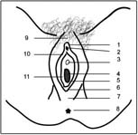
Unaltered
Unaltered female genitalia

Slide 13
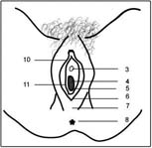
Type I: Clitoridectomy
Removal of the prepuce with or without excision of part or all of the clitoris AKA “Sunna" (meaning tradition or duty)

Slide 14
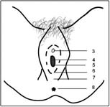
Type II: Excision
Removal of the prepuce and clitoris together with partial or total excision of the labia minora

Slide 15
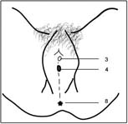
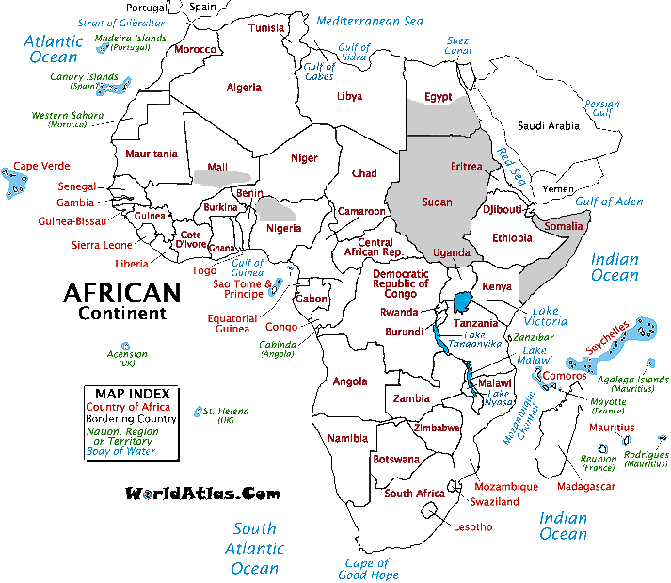
Type III: Infibulation
Usually whole, of the labia majora is scraped or cut away. The two sides of the vulva are then pinned together by silk or catgut sutures, or with thorns, thus obliterating the vaginal introitus (opening), except for a very small opening, preserved by the insertion of a tiny piece of wood or a reed, for the passage of urine and menstrual blood

Slide 16
Figure 1. Unaltered Female Genitalia
Type I Circumcision
Broad areas across Africa
Type II Circumcision
Figure 2. Type III Circumcision

Slide 17
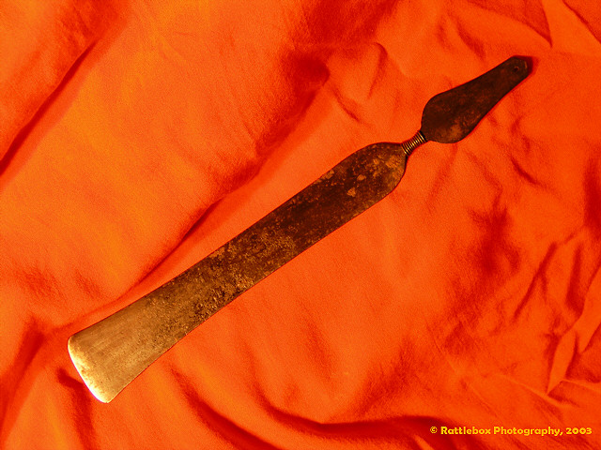
Circumcision Knife

Slide 18
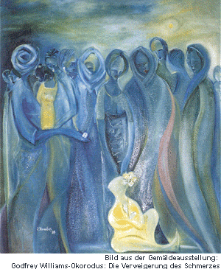
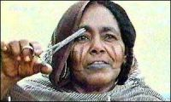
The Surgery
No anesthetic
Performed by untrained practitioners – designated individuals
Variety of cutting instruments
Female family members restrain the girl
Process is generally enforced and perpetuated by women in these societies
Untrained FGC Practitioner.(photo Vitrade).
(91 % in Côte d'Ivoire, 95 % in Eritrea, and 88 % in Mali).

Slide 19
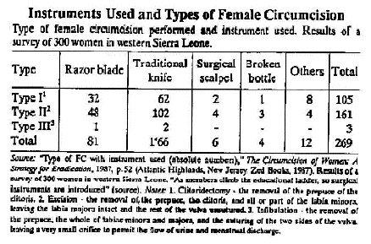
Frequency of Cutting Instruments
Knives and razor blades seem to be used more often, however data is only from one country and 300 women is a small non-representative sample of all women
  Unsterilized razors
  Broken glass
  Tin lids
  Scissors
  Dull knives
  Stone tools

Slide 20
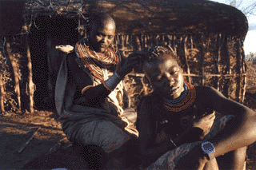
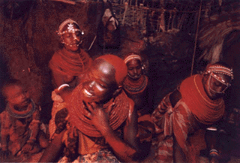
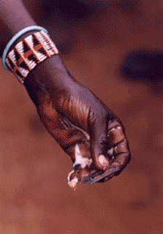
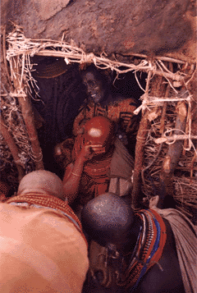
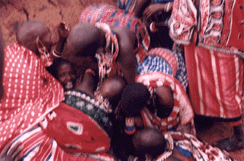
Pulitzer Prize 1996 – Stephanie Welsh Photographed a Circumcision

Slide 21
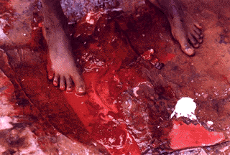
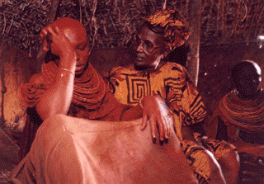
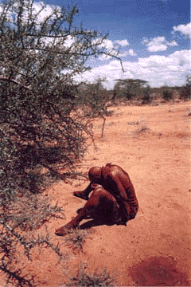
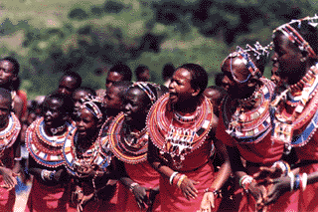
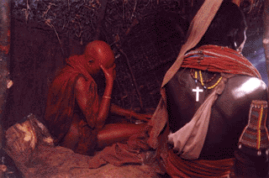

Slide 22
Medical Risks: Short Term
Severe pain
Risk of hemorrhage that can lead to shock and death
High risk of local and systemic infections
Documented reports of
  abscesses, gangrene, ulcers, delayed healing, septicemia, tetanus
Spread of diseases

Slide 23
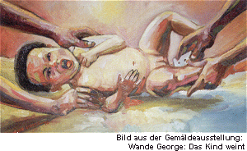
Medical Risks: Long Term
Urine retention
Repeated urinary tract infections
  (16% - Sudan)
Obstruction or abnormal menstrual flow
  (55.4% Somalia)
Frequent reproductive tract infections
Infertility
Prolonged and obstructed labor
  (up to 5 times as long)
Psychological trauma
Significantly decreased sexual drive
  (study of 1,545 Sudanese -50% did not enjoy sex at all)
Spread of HIV

Slide 24
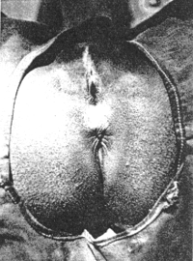
Medical Risks: Long Term
Dermoid cysts in scar tissues
Kidney damage
Stones in Bladder
Keloids (raised progressively enlarging scars)
Neuroma – trapping of clitoral nerve in tissue causing extreme pain during intercourse

Slide 25
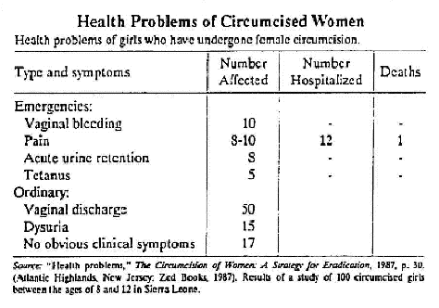
Health Problems
Many argue that FGM is more damaging than MGM and thus should be eradicated as a practice against basic human rights

Slide 26
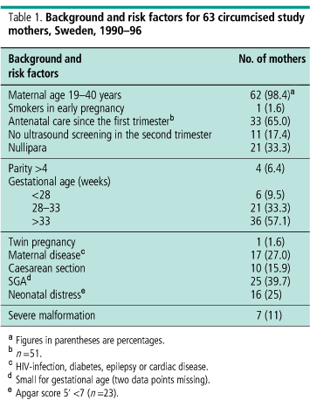
Risk Factors of FGM
40% of infants born to circumcised women were small for gestational age

Slide 27
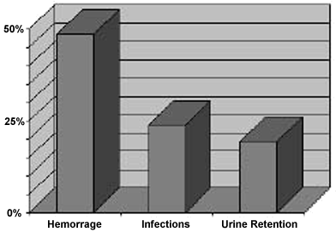
Immediate FGM-Related Complications in Four Kenyan Districts
A 1991 survey of 1,222 women in four Kenyan districts indicated that 48.5% of the women experienced hemorrhage, 23.9% infection, and 19.4% urine retention at the time of the FGM operation.23

Slide 28
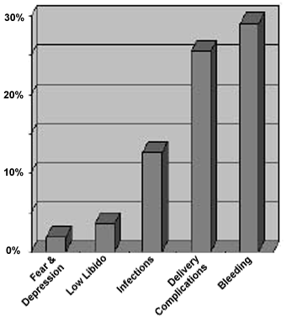
Chronic FGM-Related Complications Encountered by Health Providers in Kenya
The chronic health problems encountered by 49.1% of health providers surveyed in Kenya are bleeding (29.1%); delivery complications (25.5%); infections (12.7%); low libido (3.6%); and fear and depression (1.8%).43
Kenya: Infibulation

Slide 29
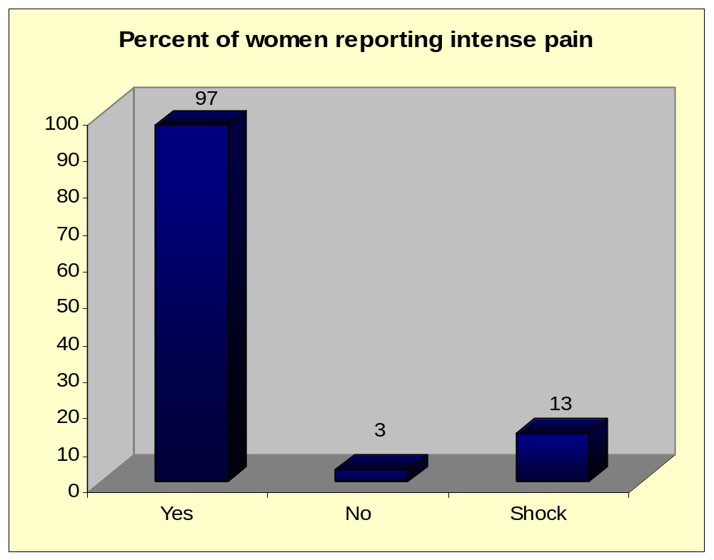
Reports of Intense Pain During and Following FGM: Sierra Leone

Slide 30
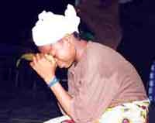
Psychological Risks
Anxiety before and for long time after
Terror
Humiliation
Betrayal of trusted family and friends
However, positive effects include feelings of acceptance by her community
Often marriage is the only opportunity for these women

Slide 31
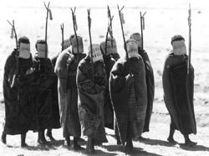
Circumcision Rite of Passage
Maake women in Lesotho,
participating in a female circumcision ceremony.
(UN Photo 187052/J. Isaac)

Slide 32
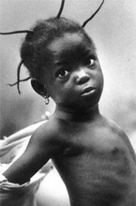
Why do it? What do the Cultures Say?
Reduces promiscuity and preserves chastity
Think the clitoris is an aggressive organ against males
Increases cleanliness
Enhances femininity
Increases marriage prospects
Offers status to the father
Necessary to become a woman
For some – means of preserving virginity
Preservation of custom – “as it has always been done”
Some cite religion, but predates muslim

Slide 33
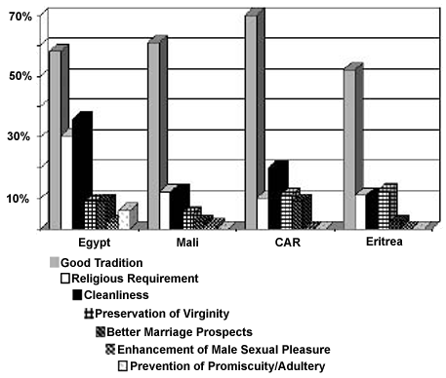
Other Reasons and Effects
Increases sexual pleasure for men?
Works to ensure paternity
Bride Price often not secured without examination that the virginity is intact
Increases perceived biological separation
“An uncircumcised woman is put to shame by her husband, who calls her 'you with the clitoris'. People say she is like a man. Her organ would prick the man..." –Egyptian Woman
Control of sexuality particularly in the case of infibulation where a woman is sewn up and cut open only for her husband
Marriage is the only secure future – mate competition means women have to provide more of what men want

Slide 34
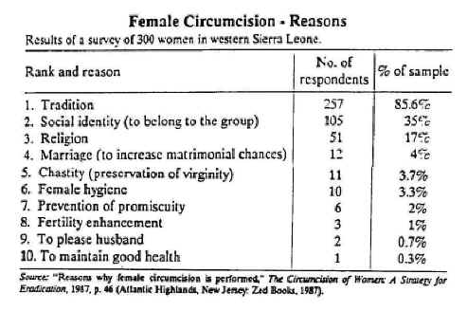
Data on Reasons for FGM

Slide 35
FGM Promotes Chastity
Nawal El-Saadawi, a Muslim victim of infibulation, stated:
"The importance given to virginity and an intact hymen in these societies is the reason why female circumcision still remains a very widespread practice despite a growing tendency, especially in urban Egypt, to do away with it as something outdated and harmful. Behind circumcision lies the belief that, by removing parts of girls' external genitals organs, sexual desire is minimized. This permits a female who has reached the dangerous age of puberty and adolescence to protect her virginity, and therefore her honor, with greater ease. Chastity was imposed on male attendants in the female harem by castration which turned them into inoffensive eunuchs. Similarly female circumcision is meant to preserve the chastity of young girls by reducing their desire for sexual intercourse." ₃

Slide 36
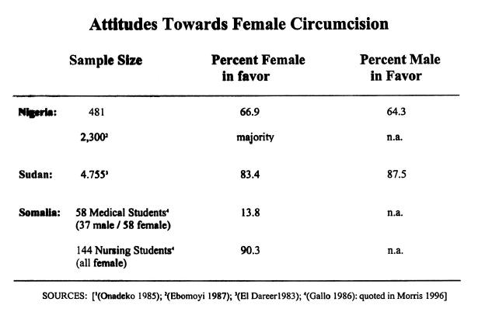
Women show strong favor for the practice
Facts do not support feminist explanations that male domination makes women do this

Slide 37
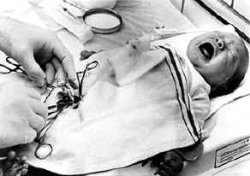
American Circumcision
Is it valid for Americans to judge other cultures when circumcision is also practiced here?

Slide 38
We tend to look down on traditional practices of body mutilation, while at the same time excusing our own because of the medical “benefits” or medicines that can prevent some of the other more serious risks associated with such procedures in cultures that don’t have access to good medical care

Slide 39
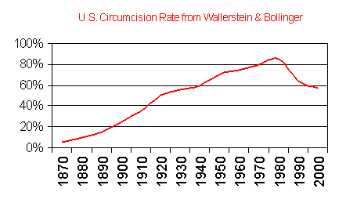
Changes in Male Circumcision
Prevalence of male circumcision peaked in 1970 and has taken a dive since
Canada 20%, Australia 15% and UK 4%

Slide 40
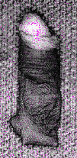
Complications
Accidents at rate of 1.5-15%
  Death
  Penises can accidentally be cut off (very rare)
  Penises can be severely mutilated
  Trapped penis (behind fat-pad)
Prior to antibiotics, swelling, hemotoma, inflammation, excessive bleeding
  Can cause disfigurement
Complications from use of anesthetics on infants
causes severe and persistent pain in newborns

Slide 41
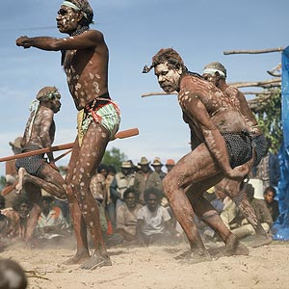
Origins of Male Circumcision
The earliest origins seem to indicate circumcision was an ethnic or cultural marker that intensified with the evolution of cultures and particularly with intergroup aggression, patrilocality and patrilineality
Similar to male chastity belts this practice gained momentum in the 19th century as a way to cleanse the body and protect one’s son from insanity and other related psychological problems due to excessive sexuality and masturbation
Circumcision Ceremony. Male Elders Ritual Dance.
Peppermenarti, Northern Territories

Slide 42
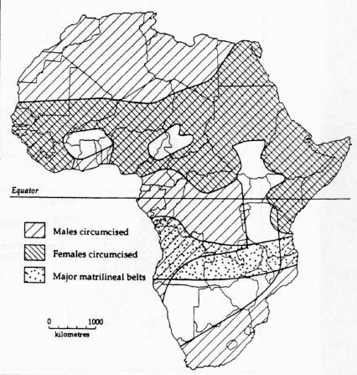
Male Circumcision in Africa
Male circumcision is very widespread throughout the world

Slide 43
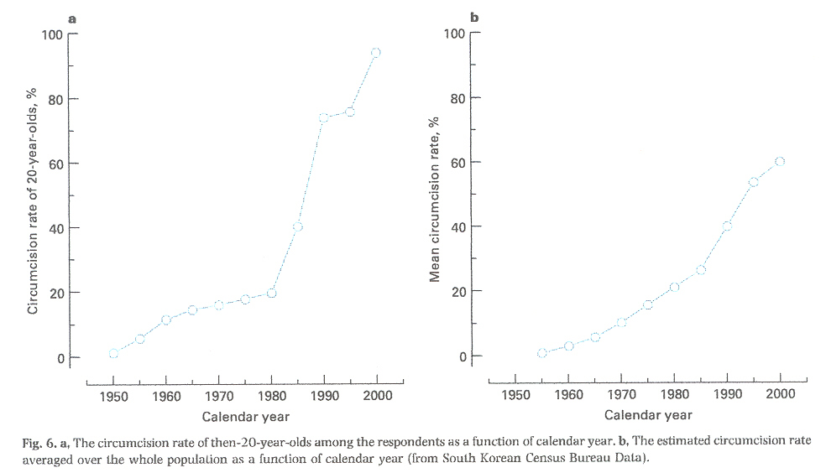
Male Circumcision
MGM increased very quickly in Korea; Most S.Korean men go to bathhouses and those not circumcised remarked of feeling embarrassed

Slide 44
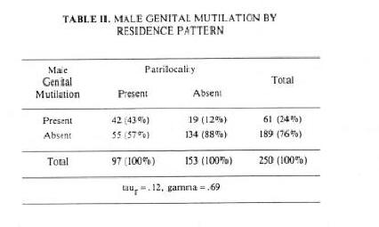
Patrilocality and Male Circumcision
Male circumcision is more likely to occur in those societies in which patrilocal residence is practiced and is more likely NOT to occur in those societies in which patrilocal residence is not practiced
In Patrilocal and patrilineal groups, men maintain strong kinship bonds
Notes:
Male circumcision is more likely to occur in those societies in which patrilocal residence is practiced and is more likely NOT to occur in those societies in which patrilocal residence is not practiced. Similarly, male circumcision is more likely to occur in those societies that are organized at the state level and is more likely NOT to occur in those societies that are organized below the state level. There is also a strong relationship between patrilocal residence and state organization: pre-industrial state-level societies are generally both patrilocal and patrilineal.

Slide 45
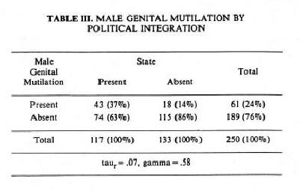
MGM and State-Societies
Male circumcision is more likely to occur in those societies that are organized at the state level and is more likely NOT to occur in those societies that are organized below the state level

Slide 46
